Slide 1
Paediatric asthma and smoking - initiative to identify and treat
Innovation for Healthcare Inequalities Programme (InHIP)

Slide 2
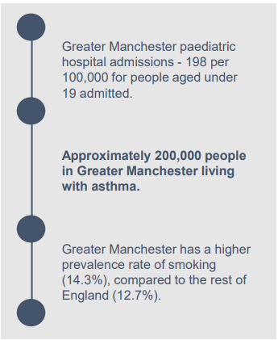
Background and context
The national Innovation for Healthcare Inequalities Programme (InHIP) was launched to address local healthcare inequalities experienced by deprived and other under-served populations, and to align with wider work between national organisations including the Accelerated Access Collaborative (AAC), NHS England’s National Healthcare Inequalities Improvement Programme and the Health Innovation Network (HIN) and to be delivered in partnership with Greater Manchester Integrated Care Partnership (ICPs).
Core20PLUS5 is a national NHS England approach to support the reduction of health inequalities at both national and system level. The approach defines a target population cohort and identifies ‘5’ focus clinical areas requiring accelerated improvement. For Children and Young People (CYP), one of the 5 clinical areas relates to decreasing the number of asthma attacks.
Greater Manchester has a high prevalence of asthma, observes high paediatric admission rates for asthma, and a higher prevalence of smoking than the England average.
Within the above context, the Greater Manchester InHIP project focused on identifying and increasing treatment rates for children admitted to paediatric wards with asthma and supporting those at increased risk of exacerbation due to living in a smoking household.

Slide 3
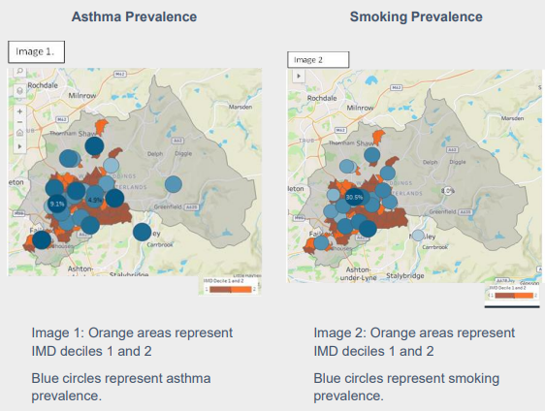
Project overview
The focus pilot site for this project was Oldham. Oldham has a high level of poverty with an Index of Multiple Deprivation (IMD) score of 33.2 and
28.9% of under 16s coming from absolute low-income families.
Annual Population Survey (APS) data from 2022 shows 10.9% of adults in Oldham are smokers. In recent years smoking prevalence has decreased in all socioeconomic groups in Oldham with the exception of never worked and long-term unemployed which has increased to 21.8%.
The images to the right (Image 1 and Image 2) show the area of Oldham with high prevalence rates for childhood asthma and smoking.
As evident in these images, the high prevalence of both asthma and
smoking is clustered within the IMD deciles 1 and 2.
This suggests a correlation between asthma, smoking and deprivation.
Data has also shown the most affected ethnic groups in Oldham to be the white British, Pakistani and Bangladeshi populations.

Slide 4
Project overview
The pilot was developed with the aim to improve paediatric asthma management given the high rates of CYP asthma in Oldham, utilising a whole-household preventative approach to asthma and smoking. The pilot offered a NICE-approved innovation of Fractional Exhaled Nitric Oxide (FeNO) testing on the hospital ward with a repeat test done in the community when the child was discharged home.
FeNO is a breath test used to monitor the level of inflammation or irritation in the lungs and aids in the diagnosis of asthma. By having a regular FeNO test, the asthma nurse can monitor whether the child’s asthma treatment plan is working, whether their prescribed medication is effective and if the child’s asthma is controlled. The test doesn’t require a trip to the hospital as it is relatively quick to perform and can be done at home or a community clinic.
If the child or young person’s asthma was determined to be uncontrolled, they were referred for specialist treatment where appropriate, to assess whether they are eligible for NICE-approved biologic therapy medication. This specialist medicine is used to help the body gain long-term control of everyday asthma symptoms, reducing the overall risk of an asthma attack.
The pilot actively identified CYP admitted to Royal Oldham Hospital (ROH) February and December 2023 with asthma or respiratory illnesses, who identify themselves as smokers or live in a household with a smoker. CYP who smoked were offered very brief advice (VBA) on stop smoking and, if eligible, prescribed nicotine replacement therapy whilst admitted to the ward and referred to the local stop smoking service, Your Health Oldham. In addition to receiving stop smoking advice, family members identified as smokers were offered the Smoke Free app which entitled them to six months’ free access to all premium features as well as up to 12 weeks’ free nicotine replacement therapy and/or refillable vaping kit. Those that were unable to use an app were referred to the local stop smoking service, Your Health Oldham.

Slide 5
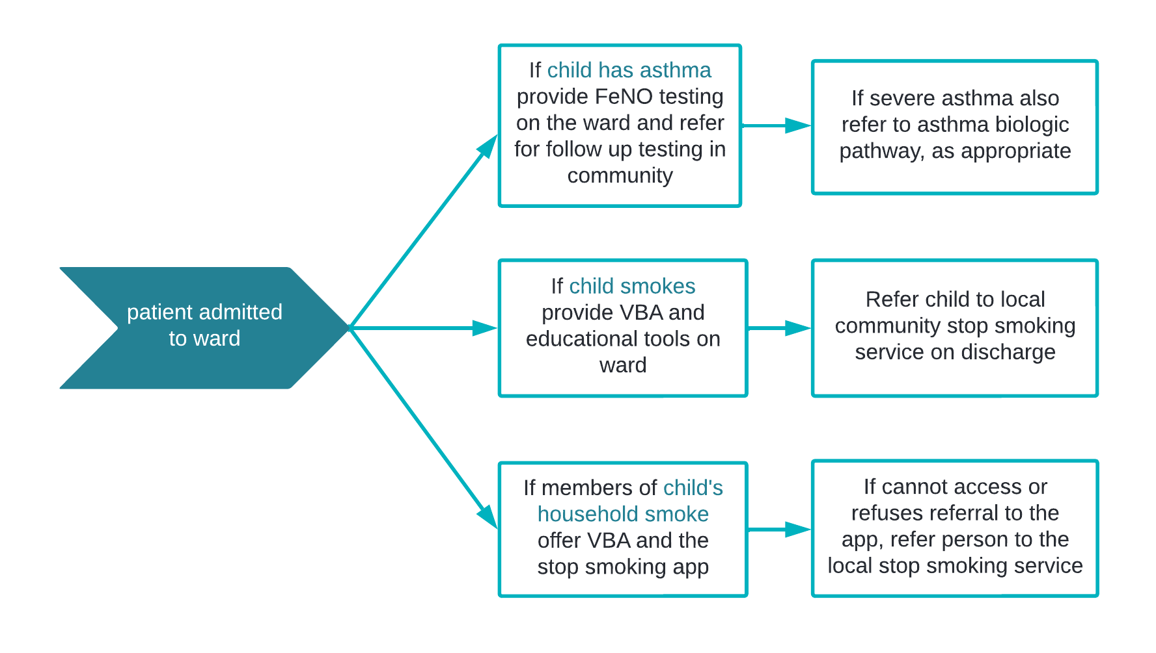
High Level Pathway

Slide 6
Monitoring and evaluation

Slide 7
Monitoring and evaluation
To evaluate the impact of the project, key data items were collected at each stage of the pathway to allow analysis from a range of demographic perspectives. To facilitate this, a data collection tool was developed for use on the hospital ward and in the community to gather demographic details, record the key interventions or referrals that took place during the hospital stay, record any identified carers for the child who smoked, and what support they received both at hospital and in the community.
In addition, data was collected via the Smoke Free app to record the number of household members who had registered with the app, to understand patient engagement and utilisation of the Smoke Free service offer, and to identify the number that had successfully quit smoking.
Your Health Oldham also provided data for patients referred to its Stop Smoking service, along with the number that had successfully quit smoking.
The Monitoring and Evaluation Framework (Appendix A) outlines the metrics that were selected for this project. In addition to this, the AAC in partnership with HIN colleagues and NHS England’s national Healthcare Inequalities Improvement Team (HIIT) developed a central framework to collate the impact of all 39 of the InHIP projects funded by NHS England across the country.
The data collection tool was used to support the completion of this InHIP central reporting framework as well as supporting the development of a Tableau performance reporting dashboard to enable interactive analysis of the outcomes of the project through dynamic visualisations and mapping techniques.

Slide 8
Demographic profile of participants

Slide 9
Participant profiles - children
93 children engaged in the project, with age ranging from 0-15yrs of age. Due to hospital admissions data identifying a seasonal rise in asthma-related emergency admissions between September – November each year, the cohort were broken down by educational phases:
26 pre-school age
47 primary school age
17 secondary school age
3 did not have a valid age recorded
37 of the participants were female, with the remaining 56 being male.
48.4% of children had confirmed asthma (n=45). The other children who did not have confirmed asthma had other respiratory conditions and/or came from a smoking household.
Half of the children admitted to the paediatric ward (50.5%, n=47) lived in a smoking household, with 1 or more carers who smoke. This includes any household member who the child spends a significant amount of time with on a regular basis, for example staying with grandparents or family members who smoke in their own homes, not necessarily smoking in the child’s home.
3 children were current or previous smokers, and 1 additional child was a current vaper.

Slide 10
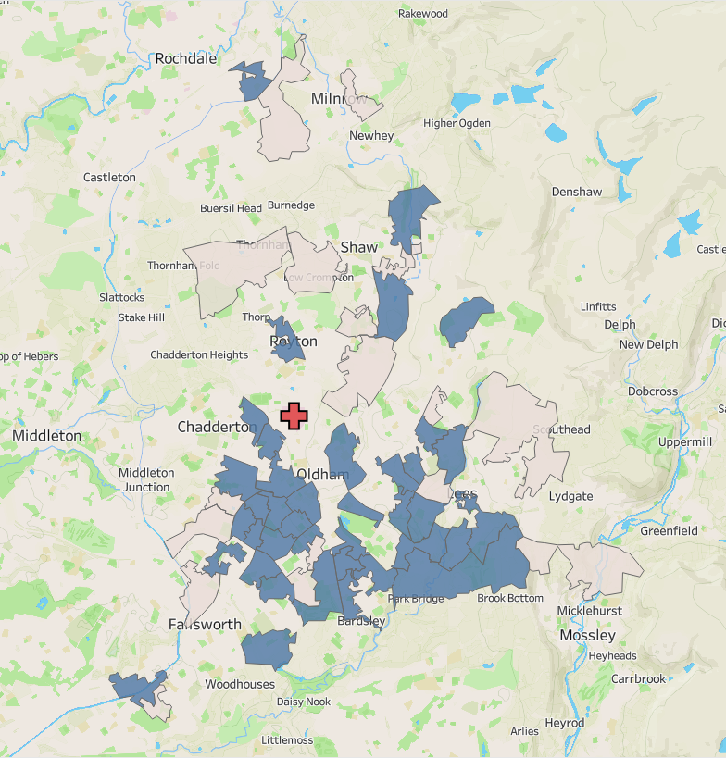
Participant profiles - children
Two thirds of the children live in the top 20% most deprived areas in the country.
53.8% of children admitted to hospital were from ethnic minority groups, highlighting the diversity in Oldham compared to other localities in Greater Manchester
Child ethnicity:
White British – 39
British Pakistani/Pakistani – 31
British Bangladeshi/Bangladeshi – 13
Other Asian background – 2
Other – 8
Royal Oldham Hospital

Slide 11
Participant profiles - adults
77 adult household members were identified (44 female, 33 male).
72 of the household members were the biological parents of the admitted child, 3 were grandparents and 1 was an Uncle.
61% of household members (n=47) live in the top 20% most deprived areas
48.1% of adult household members were from ethnic minority groups.
Relationship to the child:
Biological mother – 29
Biological father – 43
Grandparents – 3
Uncle – 1
Household member ethnicity:
White British – 40
British Pakistani/Pakistani – 21
British Bangladeshi/Bangladeshi – 10
Other – 6

Slide 12
Participant profiles – adult smokers
Of the 77 adults entered on the system, 56 were current smokers (20 of whom also vaped)
2 had previously smoked (1 of which also vaped)
And 19 had never smoked (1 of which was a current vaper)
91.1% of current smokers (n=51) smoked cigarettes or pipes, and 3.6% (n=2) smoked shisha.
94.6% of smokers were referred to Stop Smoking services:
34 household members were referred exclusively to the Smoke Free app
5 were exclusively referred to the Your Health Oldham Stop Smoking service
14 people were referred to both services.
3 people did not take up the offer of referral

Slide 13
Outcomes of the project

Slide 14
Outcomes of the project - Children
The project aims were to treat children effectively when admitted to the ward for their asthma or respiratory condition. An additional aim was to increase FeNO testing on the ward to improve accurate diagnosis of asthma severity.
Intervention | Number of children | %
FeNO test carried out on the ward | 16 | 17.2%
FeNO result successfully obtained on the ward | 7 | 7.5%
Number of children receiving oral steroids | 29 | 31.2%
Number of children assessed eligible for biologic therapy | 2 | 2.2%
Number of children referred to biologic therapy pathway | 1 | 1.1%
Number of children receiving treatment (e.g., inhalers/antibiotics) on discharge | 56 | 60.2%

Slide 15
Child’s ethnicity | Child’s age group | Number of children | Percentage of FeNO tests carried out in hospital | Percentage of children where FeNO result was successfully obtained | Percentage of children receiving oral steroids | Percentage of children assessed eligible for biologic therapy | Percentage of children referred for asthma biologics | Percentage of children receiving treatment on discharge
British Bangladeshi/Bangladeshi | Preschool | 2 | 0.0% | 0.0% | 50.0% | 50.0% | 0.0% | 50.0%
 | Primary school age | 9 | 0.0% | 0.0% | 33.3% | 0.0% | 0.0% | 66.7%
 | Secondary school age | 2 | 0.0% | 0.0% | 0.0% | 0.0% | 0.0% | 50.0%
British Pakistani/Pakistani | Preschool | 5 | 0.0% | 0.0% | 20.0% | 0.0% | 0.0% | 40.0%
 | Primary school age | 22 | 22.7% | 0.0% | 40.9% | 0.0% | 0.0% | 59.1%
 | Secondary school age | 4 | 25.0% | 25.0% | 50.0% | 25.0% | 25.0% | 50.0%
White/White British | Preschool | 18 | 5.6% | 5.6% | 16.7% | 0.0% | 0.0% | 66.7%
 | Primary school age | 12 | 25.0% | 8.3% | 41.7% | 0.0% | 0.0% | 58.3%
 | Secondary school age | 9 | 44.4% | 33.3% | 33.3% | 0.0% | 0.0% | 88.9%

Slide 16
Outcomes of the project - Children
Hospital admissions
NICE guidance states that FeNO is suitable for children aged 5yrs and older. Of the 61 children admitted aged 5yrs or over, 23.0% (n=14) had a FeNO test carried out on the ward, with only 6 successfully obtaining a result. Reasons such as poor technique or exacerbations of asthma were cited as reasons for being unable to obtain a FeNO result.
From an ethnicity perspective, FeNO testing rates were higher for white British children than for other ethnicities and most noticeably, none of the British Bangladeshi/Bangladeshi children had a FeNO test. Whilst the denominators are small and therefore not statistically significant, the variation in FeNO testing between ethnic groups warrants further research.
Nearly one third of children were documented as receiving oral steroids prior to FeNO testing whilst in hospital to manage asthma exacerbations, and nearly two thirds of children received treatment such as inhalers, antibiotics or corticosteroids.
Community appointments
42 of the 93 children admitted to hospital were seen in community follow-up clinics or at home. FeNO testing was carried out with all (100%) of the children attending. Due to the difficulties in obtaining a successful FeNO reading in the hospital, the results were not used to compare with those obtained in the community setting.
For those children where multiple FeNO readings were obtained through testing in more than one follow-up appointment (13 children), nearly half of them showed improvements/reductions in their FeNO result, indicating an improvement in their asthma following treatment and education for management to parents and eligible children.

Slide 17
Outcomes of the project – Household members
The key outcomes for household members were to receive smoking cessation support, either through the Smoke Free app or by referral to the Your Health Oldham Stop Smoking service, with the aim of encouraging a smoke-free household that will help reduce exacerbations of the child’s asthma or respiratory condition.
Intervention | Number of household members | % of smokers
Number of smoking household members provided with Stop Smoking literature on the ward | 45 | 80.4%
Number of smoking household members referred to the Smoke Free app | 48 | 85.7%
Of those referred, the number setting a quit date in the app | 21 | 43.8%
Of those setting a quit date, the number successfully quit (self-declared within the app) | 2 | 9.5%
Number of smoking household members referred to Your Health Oldham’s Stop Smoking service | 19 | 24.7%
Of those referred, the number setting a quit date with the service | 5 | 26.3%
Of those setting a quit date, the Number successfully quit | 1 | 20%

Slide 18
Outcomes of the project – Household members
Of the 77 household members engaging with the project, 58.4% (n=45) were provided with Stop Smoking literature on the ward, which indicates the effect smoking has on the child’s respiratory condition.
48 household members were referred to the Smoke Free app via a QR code that, once scanned, installs the app onto the person’s smartphone. Via the app, 21 people set a quit date, but by the end of the project timeframe only 2 people reported that they had successfully quit smoking.
19 people were referred to Your Health Oldham (25% of the smokers identified) but only 5 set a quit date, with only 1 person successfully quit by the end of the InHIP project.
Overall, the 3 successful quitters led to 3 households becoming smoke free, but this is significantly lower than anticipated. NHS Stop Smoking Services data⁽¹⁾ suggests that 53% of smokers are self-reported to have stopped smoking after 4 weeks of setting a quit date. As this data relates to smokers who are ready to quit, this suggests the lower percentage quitters engaged in this project are not ready to quit at the time of receiving the offer of support.
(1) https://digital.nhs.uk/data-and-information/publications/statistical/statistics-on-nhs-stop-smoking-services-in-england/april-2023-to-september-2023-q2

Slide 19
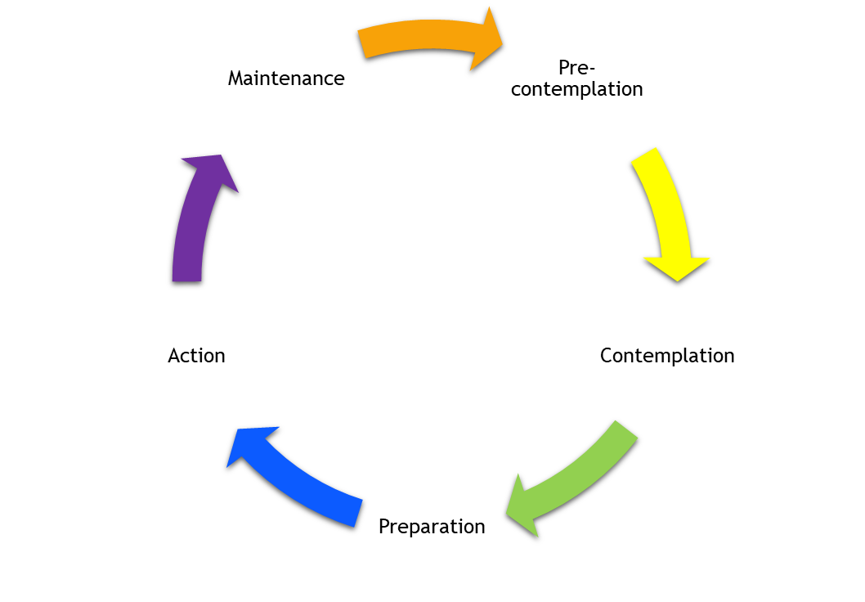
Outcomes of the project – Household members
Members of the ROH hospital team contacted household members who were identified as smokers and had not registered for the Smoke Free app. Several stated they were not ready to stop smoking at the moment.
The transtheoretical model of behaviour change⁽²⁾ suggests that capturing people in this ‘precontemplation’ stage, whilst they’re focused on dealing with their child’s asthma exacerbation rather than their own smoking, is unlikely to lead to people stopping smoking in the next few weeks or months. However, this intervention might help initiate the transition to ‘contemplation’ or ‘preparation’ for patients and therefore is still beneficial. To assess whether this is the case, a longer-term study is recommended to confirm whether the smoking household member has subsequently quit at a later date.
There were a number of patients who could not be contacted via telephone, either due to not answering the phone or because their phone number was disconnected.
Given the financial pressures that people face with the rising cost of living, especially those living in the most deprived areas, it is possible that they no longer had a smartphone or telephone line due to affordability. However, this has not been confirmed, and the project mitigates this risk by offering the referral to Your Health Oldham Stop Smoking service if the app was not a suitable approach.
(2) Prochaska, James O.; DiClemente, Carlo C. (2005). "The transtheoretical approach". In Norcross, John C.; Goldfried, Marvin R. (eds.). Handbook of psychotherapy integration. Oxford series in clinical psychology (2nd ed.). Oxford; New York: Oxford University Press. pp. 147–171.

Slide 20
Qualitative Insights

Slide 21
Gathering Feedback
Three surveys were developed to collect feedback from participants of the project, a sperate feedback survey for CYP (13 – 16yrs), parents and staff involved. The aim was to gain an understanding of their personal experience of the project pathway and support.
The accessibility of the surveys was ensured for low health literacy levels and CYP by developing the feedback surveys in alignment with the Care Quality Commission CYP hospital experience survey and using a tool to confirm the reading level of each question. After development, the surveys were agreed with the GM ICP team and the Royal Oldham staff.
The optimal method of distribution was developed in collaboration with the Royal Oldham team. During the follow up, the asthma nurse would send the MS Forms survey link for the CYP and parent to complete on their own. Project funding was also utilised for the dedicated hospital staff member to contact patient and parent participants in the project. Staff surveys were sent out to all staff that had received training as part of the project, current and previous ward staff.
Parent feedback rates were much higher than CYP or staff responses, leading to a recommendation of improving methods of gathering feedback in any future iteration of the project.

Slide 22
Feedback from Parents
Of the 42 children seen in community follow-up clinics or at home, 14 parents provided feedback on the service (33%). The feedback showed parents were well informed of the innovation and pathway.
Of the 2 parents whose children had a FeNO test, both thought the nurse or doctor explained why the test was needed and what would be done. Afterwards, the nurse or doctor explained, to both sets of parents, the result of their child's FeNO test and they understood what that meant for their child’s asthma.
Of the 6 parents with children with asthma:
100%
83%
83%
Received information on who to talk to if they were worried about anything when they got home
Knew what would happen next with their child’s asthma treatment
Said their child’s asthma improved after treatment

Slide 23
Feedback from Parents
Of these 14 parent respondents, 8 were smokers and 7 received information when in hospital or at the clinic about stopping smoking. 100% of these parents stated that the information they received was clear, and 57% stated it was helpful.
100%
57%
Received clear information on stopping smoking
Stated that stop smoking information was helpful
Free text was collected on the reasons for not engaging with the stop smoking resources, which showed this might not be the optimal time to be signposting parents to these services:
Reasons given for not registering for the smoke free app:
“Just busy”
“Lost the leaflet given at the hospital”
“Decided not to stop smoking for now”
Reasons given for not accessing stop smoking support:
“Has not looked into it properly”
“Didn't want to stop smoking for now”

Slide 24
Additional Feedback
Of the 14 surveys completed, 5 gave a comment in addition to the questions asked:
“A bit more active support in place”
“Tried to download the app but technical issues made it unavailable”
“Personally, the information was not helpful as was already aware of the information given. Have since been doing a lot better, have gone from full time smoking to smoking e-cigarettes”
“Asthma may have gotten worse because of the damp in the house”
“Our nurse Victoria is so knowledgeable, professional and kind. I have 100% confidence in her treatment plans, as it has helped my daughter so very much. Thank you”

Slide 25
Feedback from CYP
The project received one response to the CYP survey, suggesting the method of collating feedback should be amended in a future iteration of the project.
The CYP that did submit a feedback form received a good experience from the pathway.
They received a FeNO test whilst in hospital or at clinic, found the machine easy to use, were informed why they needed to do the test and how to do it and afterwards, did receive an explanation of the results.
Before their clinic appointment they were given information on the FeNO test, which they read in advance.
They felt able to ask the nurse about their asthma and were able to do so without a parent or carer being present.
After leaving the hospital or clinic, they knew who to talk to if they were worried, what was going to happen next with their asthma treatment and were given advice on how to look after themselves when they got home. After receiving treatment, their asthma improved.

Slide 26
Feedback from Staff
The project received two responses to the staff survey.
1 of 2 stated their confidence in providing a FeNO test had improved because of this pilot.
Both stated their confidence in providing patients and household members with smoking cessation advice had improved because of this pilot.
Neither of the staff thought understanding of the asthma biologics pathway had improved.
1 of 2 stated their understanding of the impact of smoking on asthma had improved.
When asked what they thought had worked well with the pilot and what could be improved:
“More patients reviewed post discharge, increase in family members stopping smoking and improved networking among all agencies involved.”
“Having a member of staff to provide the advice and referral worked well.”

Slide 27
Community Engagement
Through this pilot we have anecdotal evidence from families visiting the Royal Oldham asthma clinic showing they have little or no knowledge or education about the impact of smoking on asthma. In January 2023, the Royal Oldham hospital and the GMICP teams, as well as other stakeholders, took part in a workshop to identify current educational resources available and highlighted potential areas for development and design of key local messages.
The group concluded engagement was needed with children and families from communities in Oldham, with high childhood asthma and smoking prevalence rates who lived in highly deprived areas where high hospital admission rates were common.
We worked with a team of community specialists from Your Health Oldham to facilitate focus groups with children and families to test our assumptions, gain first-hand insights to their level of knowledge of asthma, how they manage it and its triggers, particularly smoking, and encourage them to coproduce and codesign with us information that was meaningful and relevant for them.

Slide 28
Community Engagement Feedback - Adults
Several themes emerged from the adult groups when discussing their child’s asthma and what they felt were the most important things to support their child’s asthma management. There was an acknowledgement from this group that accountability for managing and controlling their child’s asthma wasn’t just with health care professionals, but them as a family and the child themselves.
Limited opportunity for education along treatment pathway | Culture and beliefs influence asthma management and smoking practices | Fear of impact of lack of asthma management knowledge in children | Limited knowledge of the impact of 2nd/3rd hand smoke on asthma | Financial motivation for stopping smoking | Large desire for education to be accessible
Parents felt unable to access education about asthma management, across healthcare settings, whilst their child’s asthma was under control. Strong concern that materials/education was only provided once their child was unwell and in need of hospital admission. They felt that if information was more available at diagnosis and consolidated at every opportunity. | Tangible advice and guidance should be tailored to cultural experience. How, and from who, these educational messages are delivered must be considered to maximise positive impact. It is important that such resources are co-produced and co-designed to ensure they resonate appropriately. | Parents expressed worry that their children do not always understand the severity and consequences of asthma. The need for improved self-management by children and young people (CYP) was a key discussion point. Parents felt that improved knowledge of their condition would help them manage it better. | This limitation in knowledge supports anecdotal findings from partners that childhood asthma is negatively impacted when in a smoking environment. Resources demonstrating this negative impact could be developed and targeted towards smoking households of asthmatic children to increase this awareness. | The financial benefits of stopping smoking were frequently raised as motivation to quit. Many people shared quitting success stories when having set themselves a financial goal. Including this within the resources may aid parents in stopping smoking, improving the environment for their asthmatic child. | Clear appetite for increased education to aid asthma management. Participants were keen for educational resources to be made easily accessible within and out of the traditional healthcare setting. They were keen to see more access to asthma information on social media platforms.

Slide 29
Community Engagement Feedback - Adults
“I thought it (the session) was very informative, there were a lot of people here who didn’t know the effects of asthma and of smoking, however I do as I have COPD (Chronic Obstructive Pulmonary Disease). The jar of tar that was shown to us was horrible. There have also been some good suggestions come out of discussions from people. “I would think that giving examples of the harm that smoking can do and expense-wise how expensive it is. I think maybe even scaremongering could work.”
Cath, aged 75 from Failsworth, part of the AGE UK focus group
91%
LEARNED MORE ABOUT ASTHMA MANAGEMENT
100%
ENJOYED TAKING PART IN THE FOCUS GROUPS
“I thought it was a very informative session, it was good to listen to the guys who have got asthma and listening to their thoughts and what they go through, and with smoking and what that affects. Me being an anti-smoker and having a daughter who has smoked for years, learning more about everything, makes me feel a lot better as a parent. “I would say personally a video and actual footage of managing your asthma or smoking gives people more of an impact. I think it makes people curious to watch more, they might not like it but they’ll sit and watch it.”
Jeff, aged 54 from Oldham joined the focus group delivered at Mahdlo Youth Zone as a parent of a child with asthma.
97%
LEARNED MORE ABOUT THE IMPACT OF SMOKING

Slide 30
Community Engagement Feedback - CYP
Several themes emerged from the CYP groups when discussing their asthma and what they felt were the most important things to think of when considering asthma management.
Limited knowledge of asthma management techniques | Negative attitude towards smoking | Aware of cultural links with shisha smoking | Limited knowledge of the impact of 2nd/3rd hand smoke on asthma | Financial motivation for parents to stop smoking
CYP knowledge was limited. Some CYP could identify environmental factors as asthma triggers. There was little awareness of approaches of how to reduce the impact of these triggers. Educational resources targeted at CYP with asthma should be developed to improve awareness of asthma management. | Negative view on smoking and the impact on the smoker’s health. Fearful of the impact of smoking on parent’s health, highlighting their worry of their parent dying as a result rather than the impact it had on their own lung health. Adequate knowledge of the effects of smoking on someone’s health. Messaging using an asthmatic child’s voice should be targeted towards parental smokers and smoking households. | Aware of shisha, and some acknowledged the cultural links to this, with a few advising of being around family members smoking shisha. The contents of shisha and its impact were not generally understood. Gaining awareness of shisha in a familial setting may normalise this behaviour. Important to educate both CYP and adults on the impact of shisha smoking. | As with the adult groups, amongst the CYP there was also limited knowledge of what 2nd and 3rd hand smoke is and its impact on asthma. Therefore, educational resources developed on this topic would raise awareness. | As with the adults, the CYP groups highlighted they would also benefit from their parents stopping smoking as it would improve their lung health, provide opportunities for holidays and leisure activities due to the financial savings of not smoking and improve quality of life for the whole household. Targeting parents with this emotive message, utilising the child’s voice, may provide extra motivation to aid them in stopping smoking.

Slide 31
Community Engagement Feedback - CYP
95%
LEARNED MORE ABOUT ASTHMA MANAGEMENT
“There was new things that I didn’t know, it’s better not to smoke and vaping or anything like that because it’s unhealthy and it affects your body. There are some people at my school who have asthma, I would tell them what I’ve learnt today.”
Aysha, aged 10, part of the Oldham Greenhill Community Centre focus group
100%
ENJOYED TAKING PART IN THE FOCUS GROUPS
“I’ve enjoyed today, and I’ve enjoyed learning facts about why it’s bad to smoke and to smoke vapes and shisha. I know that when you don’t use your inhaler then you could get an asthma attack, you must use it quickly to help. I would tell them (people who smoke) to stop smoking to help themselves and to help the environment, and I would tell them that if they had asthma to use their inhaler to help them feel better.”
Mesamsyed, aged 11, part of the Oldham Greenhill Community Centre focus group.
100%
LEARNED MORE ABOUT THE IMPACT OF SMOKING

Slide 32
Lessons learned

Slide 33
Lessons learned – key findings
The standout successes which contributed to a streamlined development and delivery approach are:
True system partnership.
Establishing effective project governance and processes.
Effective budget and resource management.
Taking an innovative approach to data capture aligned to DPIA approval.
Being a solution focused stakeholder team.
Gaining clinical and Caldicott guardian data sign-off.
Ensuring strong and meaningful community collaboration.
Launching an impactful comms campaign.
In addition, key learnings to take forward to future projects are:
Consider future proofing and sustainability requirements during project development.
Build in contingencies to avoid a single-point of failure.
Prioritise and develop a robust plan/timeline for community co-production activities.
Carry out extensive stakeholder analysis to ensure inclusion of appropriate teams/individuals.
Confirm clarity of roles and responsibilities to avoid confusion and promote accountability.
Provide clear project direction via a defined scope, regularly referring stakeholders back to it.
Ensure the budget is allocated effectively to aid optimal staffing and onboarding to smoking cessation services.

Slide 34
Conclusion

Slide 35
Conclusion
The inter-relationship between smoking and asthma was supported by the findings of this project, in that more than 50% of children admitted to the paediatric ward for asthma or respiratory condition lived in a smoking household.
The NHS England InHIP was launched to address local healthcare inequalities experienced by deprived and other under-served populations. The cohort of patients engaging with the project met this criteria, with 54% of children coming from ethnic minority backgrounds (higher than the Oldham ethnic minority population of 31.9%⁽³⁾) and two thirds of families living in the top 20% most deprived areas in England.
FeNO testing on the ward was problematic and was carried out more successfully in the community follow-up setting. For those with comparable FeNO readings, half saw a reduction in their FeNO score suggesting the treatment provided was having a positive impact on the child’s asthma.
Data suggests the household members who were identified as smokers on the ward and referred to stop smoking services were not yet ready to quit smoking, despite the offer of support and NRT. Further research is recommended to see if people subsequently quit at a later date following this initial intervention related to their child’s respiratory condition.
The potential for increased uptake of the Smoke Free app through more effective onboarding on the ward and more effective follow-up in the community and within the app also warrants further investigation.
Whilst the offer of a face-to-face appointment with Your Health Oldham aimed to mitigate the potential risk of digital exclusion, this may warrant further research to ensure an app-based approach can be effectively rolled out further.
(3) ONS Census 2021 data - https://www.ons.gov.uk/datasets/TS022/editions/2021/versions/1

Slide 36
Appendix

Slide 37
Appendix A – Monitoring and evaluation framework
Metric | Data source
Number of children admitted to hospital | InHIP database
Number of children from smoking households | InHIP database
Number of carers who smoke and/or vape | InHIP database
Number of children who smoke and/or vape | InHIP database
Number of smokers referred to the Smoke Free app | InHIP database
Number of smokers referred to the Your Health Oldham Stop Smoking service | InHIP database
Number of smokers setting a quit date via the Smoke Free app | Smoke Free app data
Number of smokers setting a quit date via the YHO Stop Smoking service | Your Health Oldham data
Number of smokers successfully quit via the Smoke Free app | Smoke Free app data
Number of smokers successfully quit via the YHO Stop Smoking service | Your Health Oldham data
Number of children reporting a reduction in their FeNO score on follow-up | InHIP database

Slide 38
Abbreviations

Slide 39
List of Abbreviations
AAC: Accelerated Access Collaborative
APS: Annual Population Survey
CYP: Children and Young People
FeNO: Fractional Exhaled Nitric Oxide
GM ICP: Integrated Care Partnership
HIIT: Healthcare Inequalities Improvement Team
HIN: Health Innovation Network
InHIP: Innovation for Healthcare Inequalities Programme
IMD: Index of Multiple Deprivation
ROH: Royal Oldham Hospital
VBA: Very Brief Advice

